Slide 2
WHAT IS FINANCIAL AID?
Financial Aid is money that helps students, and their families pay for college.
This assistance covers educational expenses which include:
Tuition and fees
Room and board
Books and supplies
Transportation
There are several types of financial aid that can come from federal, state, and institutions like HCC, including grants, scholarships, work-study, and loans.

Slide 3
TYPES OF AID

Slide 4
GRANTS:
Federal Pell Grant (Pell)
Federal Pell Grants | Federal Student Aid
Federal Supplemental Education Opportunity Grant (FSEOG)
FSEOG (Grants) | Federal Student Aid
Texas Educational Opportunity Grant (TEOG)
Texas Educational Opportunity Grant | Houston Community College - HCC (hccs.edu)
Texas Public Education Grant (TPEG)
Texas Public Education Grant | Houston Community College - HCC (hccs.edu)
TEACH Grant
TEACH Grant | Houston Community College - HCC (hccs.edu)
State Grants
Institutional Grants
*For more information on grants, please visit:
Grants | Houston Community College - HCC (hccs.edu)

Slide 5
SCHOLARSHIPS
Organizations related to your field of interest
Ethnicity-based
Your employer or your parent’s employers
Religious or community organizations
Local businesses or civic groups
Institutional
Scholarships | Houston Community College - HCC (hccs.edu)
* See the following for more:
The Ultimate Scholarship Book 2024: Billions... by Tanabe, Gen (amazon.com)

Slide 6
SCAMS!!!!
Be aware of potential scholarship scams. The following sites are excellent resources to identify potential scholarship scams.
FinAid: Scholarship Scams - Finaid
Federal Trade Commission: How To Avoid Scholarship and Financial Aid Scams | Consumer Advice (ftc.gov)

Slide 7
TRADITIONAL WORK-STUDY & PATH TO PROFESSION
Traditional Work-Study
Based on demonstrated need
Student can obtain an on-campus OR off-campus job
15 – 19.5 hours per week and paid directly to student
Wages varies based on institution and position
Pay rate $15.00 per hour
Path To Profession
Allows students to be paid for apprenticeships, internships, clinical rotations, and other career-related positions with community partners
Students are permitted to work up to 40 hours per week
Hourly pay rate of $15.00
Path to Profession (Work-Study) | Houston Community College - HCC (hccs.edu)

Slide 8
LOANS
Direct Subsidized and Unsubsidized loans
Subsidized and Unsubsidized Loans | Federal Student Aid
PLUS (Parent Loan for Undergraduate Students)
PLUS Loan Application | Federal Student Aid
Private Loans (Not Recommended)
All student loans must be accepted, and the following must be completed on Home | Federal Student Aid:
Master Promissory Note:
Completing a Master Promissory Note | Federal Student Aid
Entrance Counseling:
Entrance Counseling | Federal Student Aid

Slide 9
WHAT IS FAFSA?
FREE
APPLICATION FOR
FEDERAL
STUDENT
AID

Slide 10
HOW DO I APPLY FOR FAFSA?
The FAFSA is not yet available due to important changes being made to the application:
Learn about the changes here: FAFSA Updates | Federal Student Aid - Financial Aid Toolkit
Use https://studentaid.gov/ Never pay to file your FAFSA application
Remember December!
Check back for the launch date at https://studentaid.gov/
As of now, the date is planned for December.
Stay informed: Launch of the 2024–25 FAFSA® Form | Federal Student Aid
Student Aid Estimator Tool for 2024-2025: Federal Student Aid Estimator | Federal Student Aid

Slide 11
AFTER YOUR SUBMISSION
Receive e-mail notification when FAFSA is processed
FAFSA information is sent to school(s) listed
School(s) use FAFSA information to determine financial aid eligibility
School(s) will contact you if they need more information or when they have determined the total aid, they can offer you
Contact your school(s) with questions about your financial aid award

Slide 12
SPECIAL CASES
The Free Application for Federal Student Aid (FAFSA) does not allow students and/or their families the ability to explain special cases, and/or hardships they may be experiencing during a particular student aid year. As a result, students who are experiencing a special case and/or a hardship, can contact a financial aid administrator at Houston Community College (HCC) to discuss their special case and/or hardship in further detail, to determine if they are eligible for a Professional Judgement. Professional Judgements are completed on a case-by-case basis, and the school may override a student’s financial aid status in some cases.
Special Circumstances - FAFSA | Houston Community College - HCC (hccs.edu)
Examples of Special Cases:
A Dependent student unable to provide parental information
A student who is homeless or at risk of being homeless
A student who is only requesting an unsubsidized loan
Changes in student and/or their family's income due to:
Loss of employment
Loss of Income (EX: Alimony, Child Support, Retirement/Pension, Social Security(taxed), Workers Compensation)
Death of Spouse
Separation or Divorce
Medical/Dental Expense
Other (EX: Natural Disaster, Secondary Tuition or other unusual cost)

Slide 13
SAP- Satisfactory Academic Progress
Financial Aid students must be in good Academic Status to continue to receive Financial Aid.
Requirements:
Maintain 2.0 cumulative grade point average (GPA)
Complete and pass a minimum of 67% of all the credit hours attempted For every class hour you attempt, you MUST complete and pass a minimum of 67% of them. Remember, all “attempted” credit hours is every hour you‘re enrolled, including repeat courses, developmental courses, and EVEN courses with grades of “F”, “W”, “I”, or “IP.“
EXAMPLE: if a student enrolls for 15 credit hours, and completes at least 10.5 of the 15 credit hours, they have met the minimum.
Credit hours earned depends on grade in course
An example using a 4 credit course: A=4 credits, B=3 credits, C=2 credits
Complete degree or certificate requirements within 150% of the minimum number of hours required to graduate. The percentage is a bit confusing. Here is a simple equation – multiply the minimum number of credit hours to complete your degree or certificate by 1.5.
Go to your institutions website to view degree plan for number of credit hours.
Awards by Program - Houston Community College - Acalog ACMS™ (hccs.edu)
I want to major in Computer Science (A.S.). I need a total of 60 credit hours to graduate. 60 x 1.5=90
Therefore, I am eligible for financial aid up to 90 attempted and completed credit hours---and no more. Beyond 90, I must pay out of pocket.
For more details and the procedures for those who fall below minimum number of hours (such as warning, financial aid suspension, appeal process), visit:
Satisfactory Academic Progress | Houston Community College - HCC (hccs.edu)
For more details on eligibility and what is considered full-time, part-time, etc. by Financial Aid:
Eligibility | Houston Community College - HCC (hccs.edu)

Slide 14
WHAT IS TASFA?
The Texas Application for State Financial Aid (TASFA) is used to collect information to help determine eligibility for state financial aid programs that are administered by institutions of higher education in the state of Texas. (2024-2025 is not yet available—it is delayed; the paper version will be available in December). Visit the following link:
TASFA - Texas Higher Education Coordinating Board

Slide 15
GET STARTED WITH TASFA

Slide 16
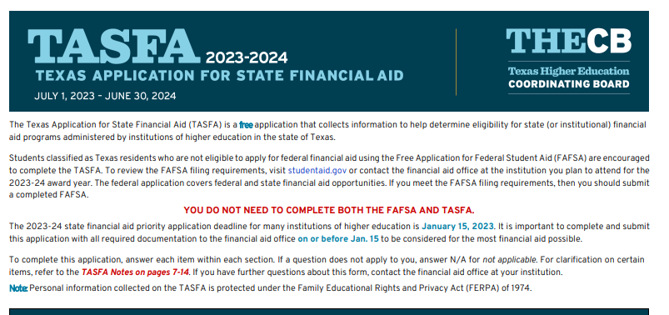
EXAMPLE: TASFA APPLICATION 2023-24

Slide 17
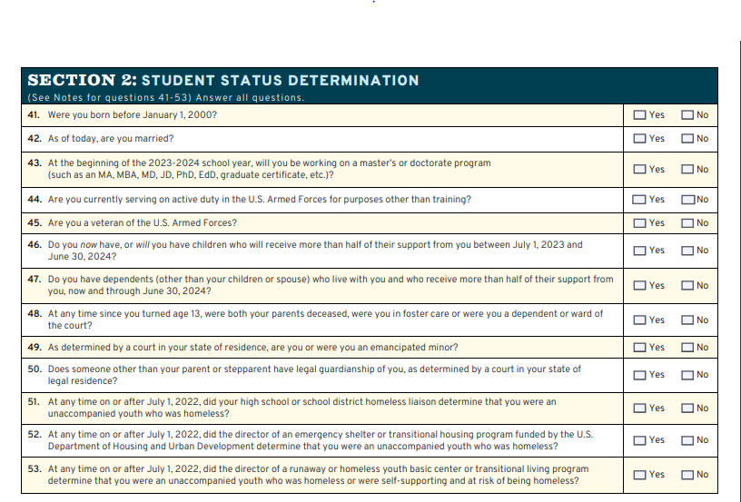
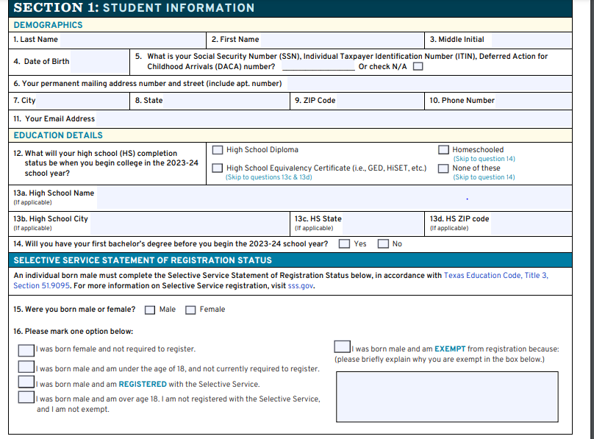
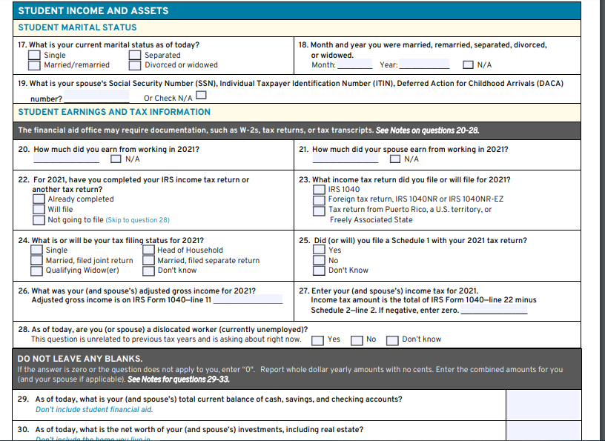
TASFA | SECTION 1 & 2

Slide 18
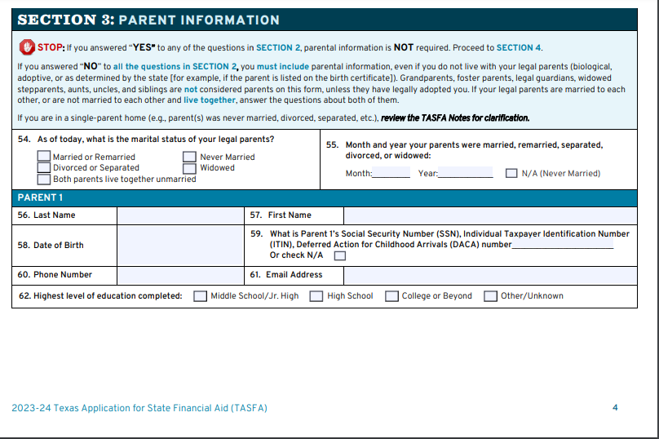
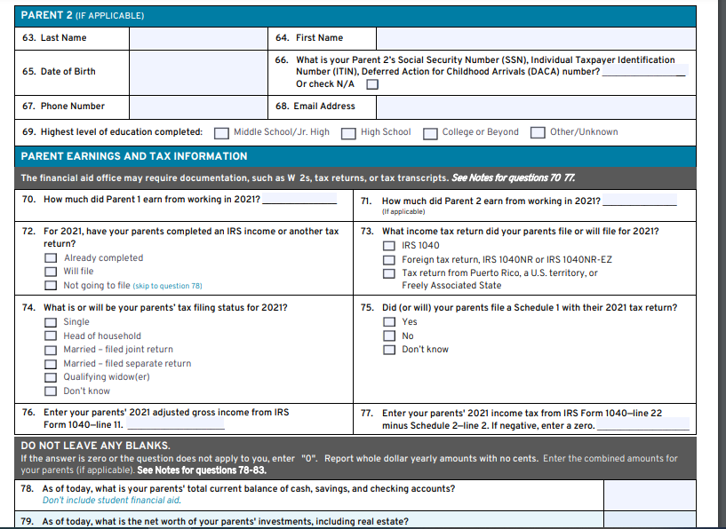
TASFA | SECTION 3 & 4

Slide 19
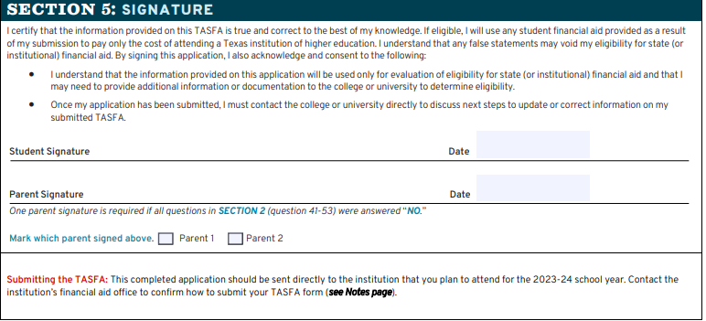
TASFA | SECTION 5

Slide 20
AWARDS FOR TASFA APPLICANTS
Grants- Free Money
Texas Education Opportunity Grant (TEOG)
Texas Public Education Grant (TPEG)
Work-Study
State
Institutional Scholarships
Variety of Scholarships available for undocumented students

Slide 21
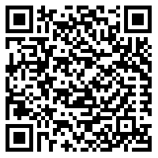
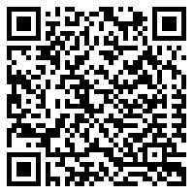
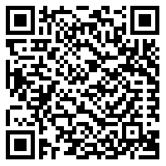
HELPFUL RESOURCES
Visit our Financial Aid webpage to find:
How to Apply for Financial Aid
Scholarship Opportunities
Eagle Promise (Not Available to KISD students)
Support for Financial Emergencies
FA Student Resolution Center:
For financial aid issues that need reviewed by an FA staff member
Financial Aid COVID-19 Q&A:
FA services that have been impacted by COVID-19

Slide 22
FINANCIAL AID CONTACT INFO
CALL CENTER | (713) 718-2000, option 2
EMAIL | finaid.district@hccs.edu
FA WEBSITE:
FA COVID-19 Q&A:
FA ZOOM LOBBY:

Slide 23
Houston Community College Tuition Costs
Tuition Calculator | Houston Community College (HCC) | We are Houston's Community College (hccs.edu)

Slide 25
Application and Advising Aids

Slide 26
Applications

Slide 27
ApplyTexas and Common App
ApplyTexas - Applicant Home Page
Apply to many Texas institutions of higher education (your created profile will prepopulate the application for each institution).
Apply to college with Common App | Your future starts here
Apply to many institutions of higher education (your created profile will prepopulate the application for each institution).

Slide 28
Costs of applications
Some are free applications
HCC is FREE!
Check with your career counselor to see if you are eligible for a fee waiver.

Slide 29
Degree Planning

Slide 30
Programs and Pathways
I spoke with many of you after the presentation. The following slides include helpful links for career exploration and degree planning.
Look at the career field or graduate program to help you decide and plan on your degree program.
Houston Community College - Acalog ACMS™ (hccs.edu)
Transfers | Houston Community College (HCC) | We are Houston's Community College (hccs.edu)
TMDSAS Homepage for Medical, Dental, and Veterinarian interests
Engineering document I created if interested in one of our pathways
Not sure what to do?
Look for a free career assessment: hccs.lightcastcc.com/?radius=&region=Houston-The Woodlands-Sugar Land%2C TX
Interview or request to shadow a professional in a particular field (most love to inform and help students!)

Slide 31
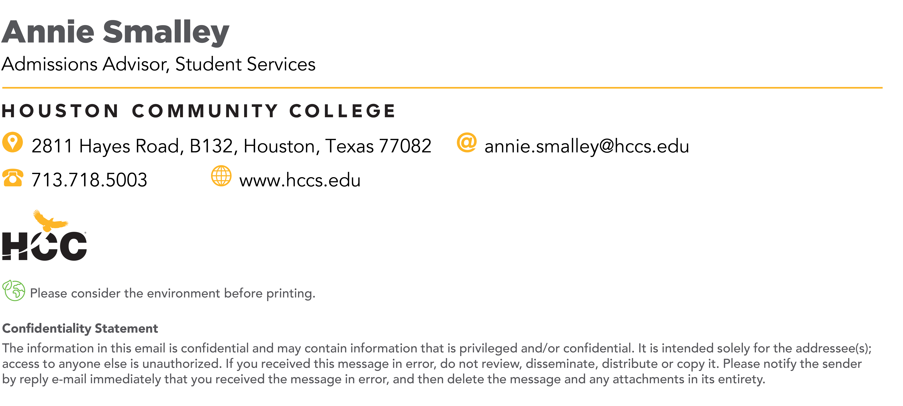
My contact information
I revised Financial Aid’s presentation to include direct and helpful links
I can help your student with any HCCS advising or application help (but also don’t mind discussing general career advice or other programs that may be the appropriate fit for your student).

